Slide 1
Healthy Food and Junk
Food

Slide 2
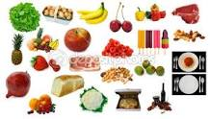
All of us love to eat food.Below are different variety of food.

Slide 3
Some food is good for health and some are bad .

Slide 4
Food which is good for our health is called healthy food and which is not good is called junk food.

Slide 5
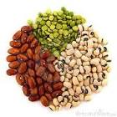
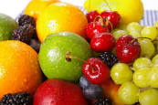
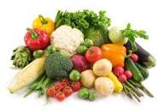
Healthy Food

Slide 6
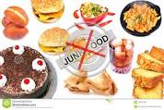
Junk Food

Slide 7
Created by Monika G Roy

